Slide 1


Dept. of CS&E ( DATA SCIENCE)
Adichunchanagiri Institute of Technology
Chikkamagaluru – 577102
Mini project– final presentation
“Electricity Billing Management System“
Presented By,
GuruKiran K S (USN:4AI23CD400)
Hemanth.mk (USN:4AI22CD030 ) Supreeth.VS (USN:4AI22CD057) Harsha M G (USN 4AI22CD024)
Under the Guidance of Prof. Gagana madam

Slide 2

Electricity Billing Management System
The Electricity Billing Management System is designed to the billing process for electricity consumption. Our aims to create a website ,where user can login ,overview user’s data like power consumption , taxes and also to pay bills in online.

Slide 3
Problem Statement:
Electricity bill aims to implement the system that will help to ensure that it meets the needs of all stakeholders,and leads to a more efficient and customer-friendly billing process.

Slide 4
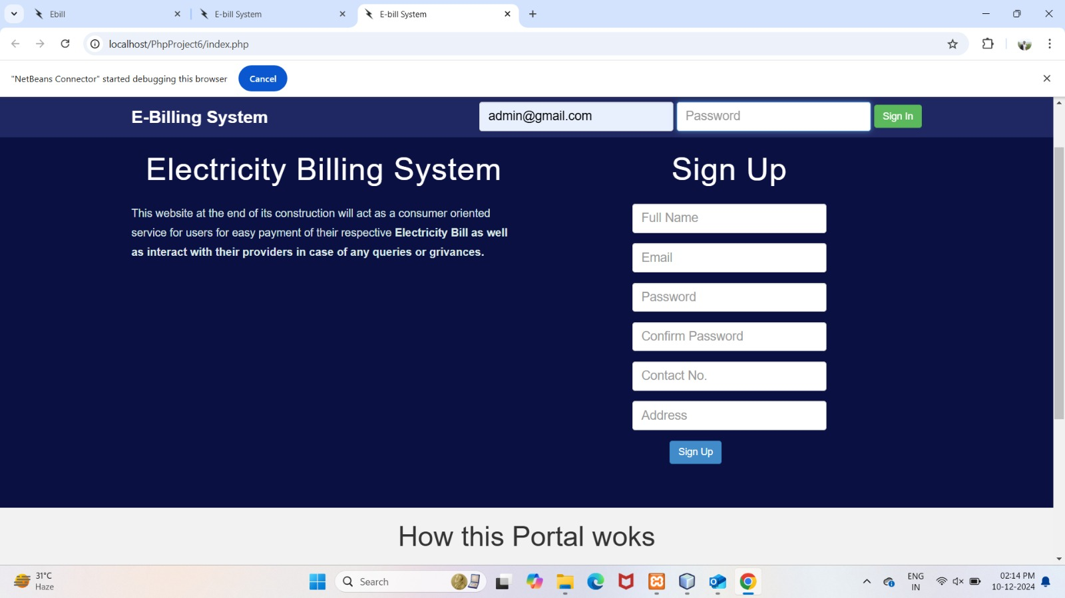
Home page

Slide 5
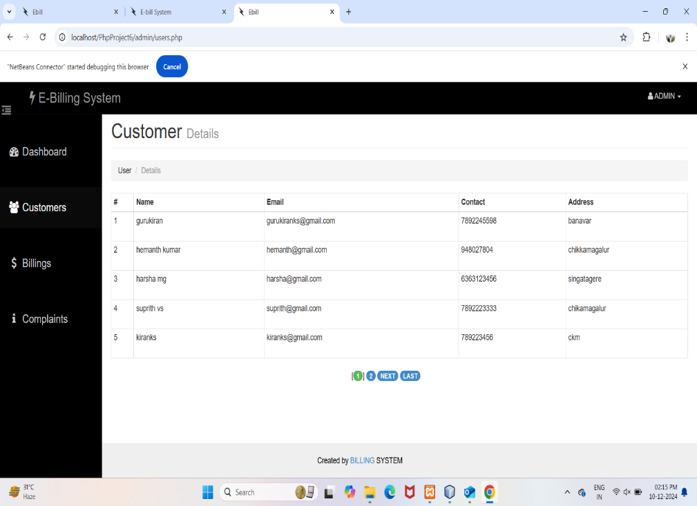
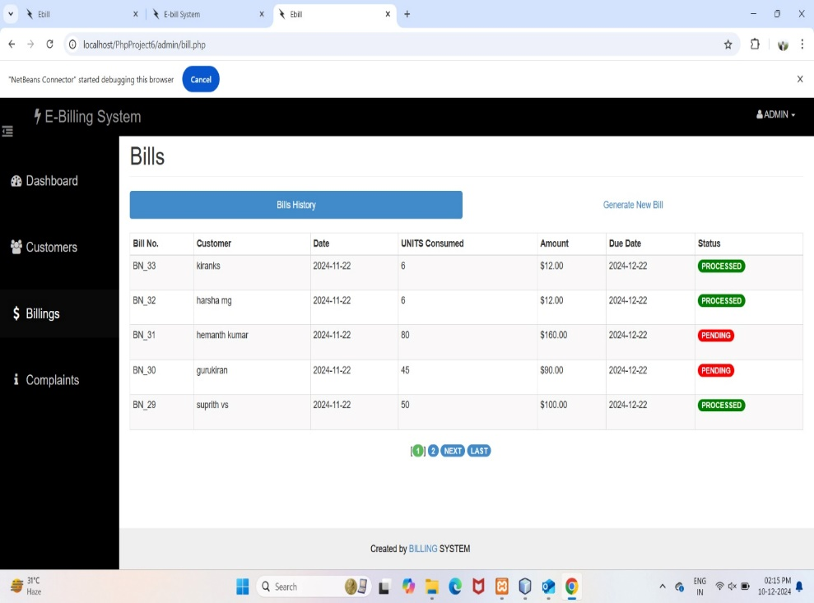
Customer details
Bill transaction

Slide 6
OBJECTIVE OF THE PROJECT:-
This project is an innovation ,which makes the way of paying electricity bills simple compared to the other existing projects.
This project has been implemented using php as front end mysql as the back end.
It maintains the error free database and easily incorporates the future
Developments and changes .
To develop an well – designed database to store customer information

Slide 7
ADVANTAGE OF PROJECT:-
Minimize the handwritten work from admission to billing department.
It will helps to minimize your repeated works .
It is a huge time saver and facilitates proper communication among the management staff,and the customers.
Provide computerized system for maintaining records.
Avoid human storage with less computer memory.

Slide 8
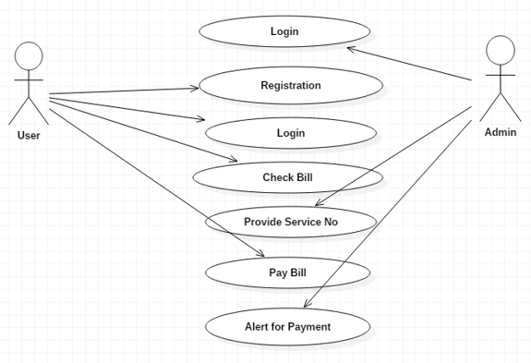
Methodology

Slide 9
Tools and Technology
Language: php ,html ,css , java.
Database : MySQL
Server: localhost.

Slide 10
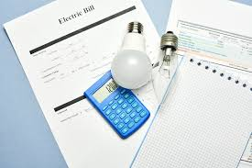
Key Features
User Registration and Authentication
Automated Billing
Payment Processing
User Dashboard
Notifications and Alerts
Reporting and Analytics
Customer Support
Data Security

Slide 11

Expected Outcomes
● Improved Accuracy and Efficiency
● Greater Customer Satisfaction
● Real-Time Data Insights
● Faster Payment Processing
● Comprehensive Reporting
● Flexibility in Pricing Models

Slide 12

Results

Slide 13
FUTURE SCOPE OF THE PROJECT:-
We can provide SMS based alerts and email notifications for billing .
The wallet can be developed to handle discounts on the points basis.
It can be also be used to provide referral code concept for referring friends.
Electricity billing system will enable the customer and billing . department made think faster and get information quickly.
If we want any information about bill /slip etc.

Slide 14
Thank You

